Slide 1
BANK MARKETING
CAMPAIGN ANALYSIS
Business Analytics Case Study — Week 5
Bank Marketing Dataset • 11,162 Customers • 17 Variables
AnalystLab Africa Internship | Week 5
Abioye Stephen Ayodeji • July 2026

Slide 2
Business Problem
What challenge is the bank trying to solve?
"Why do some customers subscribe to term deposits while others do not — and which segments should the bank prioritise to maximise conversion and reduce wasted campaign spend?"
01
High campaign cost
Calling non-converting customers wastes agent time and budget
02
Poor targeting
All customer segments treated equally despite very different conversion rates
03
Timing inefficiency
Campaigns run heavily in low-conversion months like May (32.8%)
04
Data quality gaps
Unknown contact methods result in only 22.6% conversion

Slide 3
Dataset Overview
Bank Marketing Dataset — 11,162 customer records from a Portuguese banking institution
11,162
17
47.4%
Zero
Customers
Variables
Conversion Rate
Missing Values
Total records
Data columns
Overall subscription
Clean dataset
Key Variable Categories
Demographics: Age, Job, Marital, Education
Financial: Balance, Housing Loan, Personal Loan
Campaign: Contact Method, Month, Call Duration
Previous: Prior campaign outcome (poutcome)
Target: deposit — yes or no

Slide 4
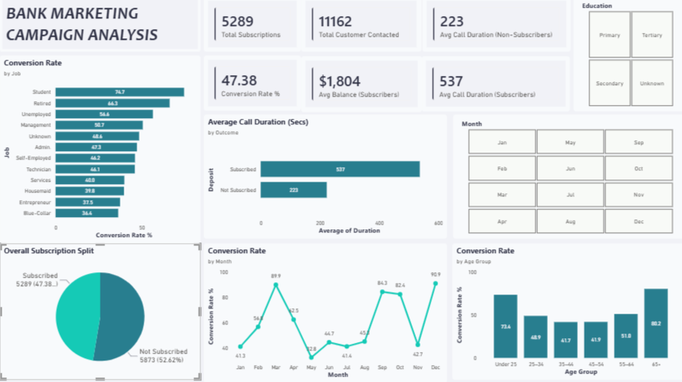

Slide 5
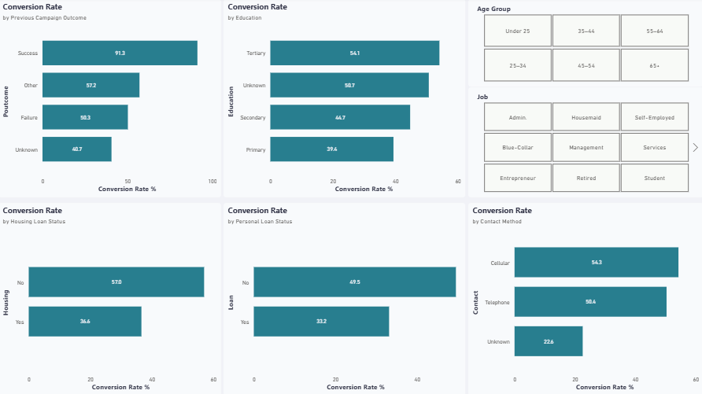

Slide 6
Key Insights
Six critical findings from the Bank Marketing analysis
1
Previous Success = 91.3% Re-conversion
2
Students & Retirees Are High-Value Segments
The single strongest predictor. Customers who subscribed before will almost certainly subscribe again.
74.7% and 66.3% conversion rates — far above the 47.4% average. Significantly underserved.
3
U-Shaped Age Pattern
4
Campaign Timing is Poorly Optimised
Under-25s convert at 73.4% and 65+ at 80.2%. Middle-aged (35–54) are the hardest segment at ~41%.
December (90.9%), March (89.9%), September (84.3%) and October (82.4%) are best. May (32.8%) is worst yet likely heaviest.
5
Longer Calls = More Subscriptions
6
Debt Burden Kills Conversion
Subscribers averaged 537 seconds vs 223 for non-subscribers. Engagement quality drives outcomes.
Customers with housing loans convert at 36.6% vs 57.0% for debt-free. Existing obligations are a barrier.

Slide 7
Business Recommendations
Six actionable steps to improve campaign ROI and subscription rates
1
HIGH
Create a Priority Re-Engagement List
Target previous subscribers first — 91.3% re-conversion rate. Highest ROI activity available.
2
HIGH
Realign Campaign Calendar
Focus in March, Sep, Oct, Dec. Reduce May campaigns. Same budget, dramatically better results.
3
HIGH
Build Campaigns for Students & Retirees
Tailor messaging and products to these two high-converting, underserved segments.
4
MED
Train Agents for Longer Engagement
Target 7–9 minute calls for warm prospects. Longer conversations consistently yield subscriptions.
5
MED
Improve CRM Data Quality
Require valid cellular numbers before campaign listing. Close the 31-point contact method gap.
6
MED
De-prioritise High-Debt Profiles
Filter dual-loan customers to lower priority. Reallocate resources to debt-free segments (57% conversion).

Slide 8
Conclusion
Smart targeting, not more calls, is the path to better conversion.
The bank's best customers are already identified — previous subscribers (91.3% re-conversion) are a near-guaranteed revenue source
Shifting campaign timing to high-conversion months can dramatically improve results without increasing budget
Students and retired customers are a high-value, underserved segment that deserves dedicated campaign investment
Data quality and CRM hygiene directly impact conversion — unknown contacts convert at less than half the rate of cellular contacts
Agent engagement quality, measured through call duration, is a controllable lever that training can improve immediately
AnalystLab Africa | Week 5 | July 2026
Abioye Stephen Ayodeji • github.com/Stephenabioye

